Slide 1
A Prognostic System

Slide 2
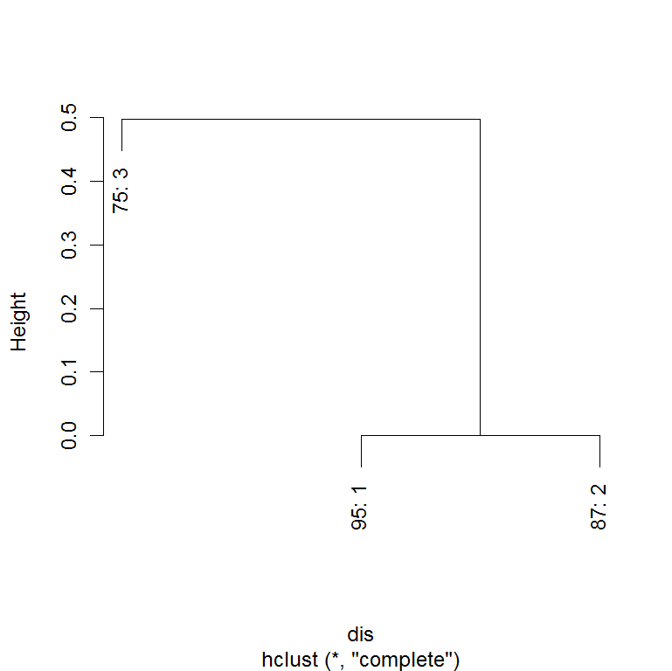
Dendrogram for Histological Grade

Slide 3

Dendrogram for Tumor Size

Slide 4
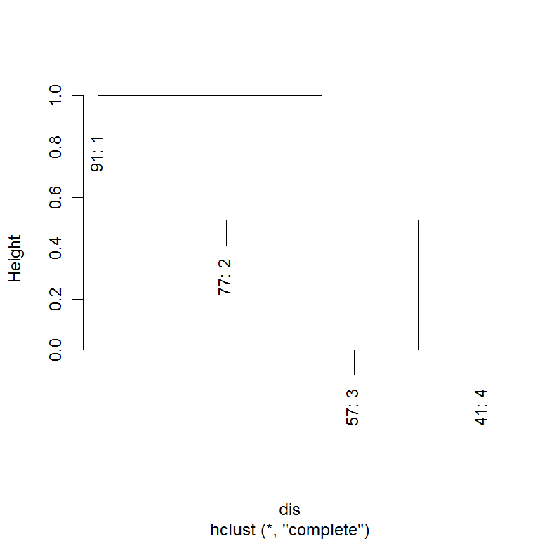
Dendrogram for Number of Positive Lymph Nodes

Slide 5
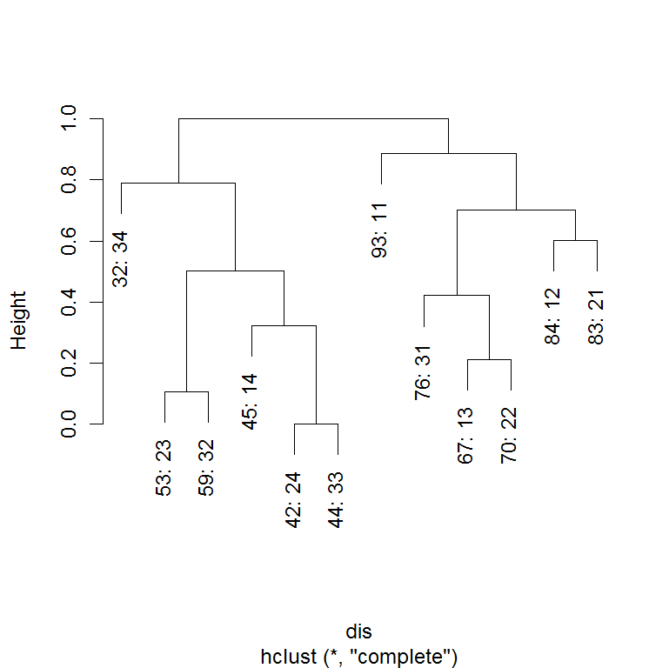
Combining T and N Produces the AJCC Staging System

Slide 6
T,N System Forms 2 Broad Groups

Slide 7
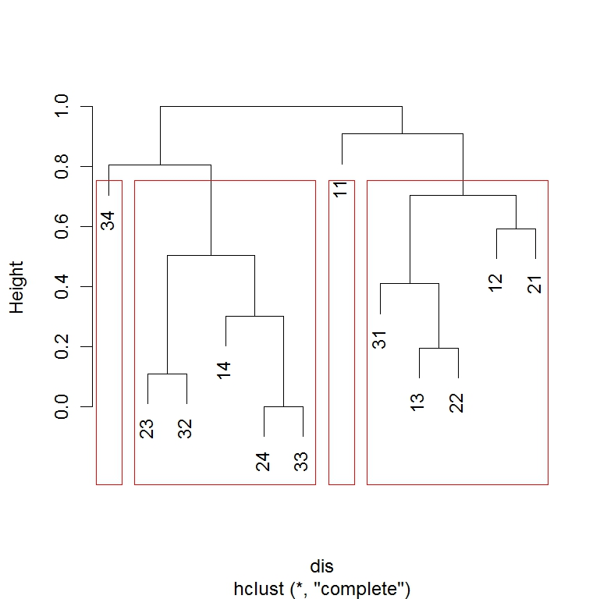
Depending on Level of Cut, Additional Groups can be Created
1
2
3
4

Slide 8
10-Year Survival Rates of 4 Groups Shown in Previous Slide
3
4
2
1

Slide 10
Six Stage Grouping on Cutting the Dendrogram for Breast Cancer

Slide 11
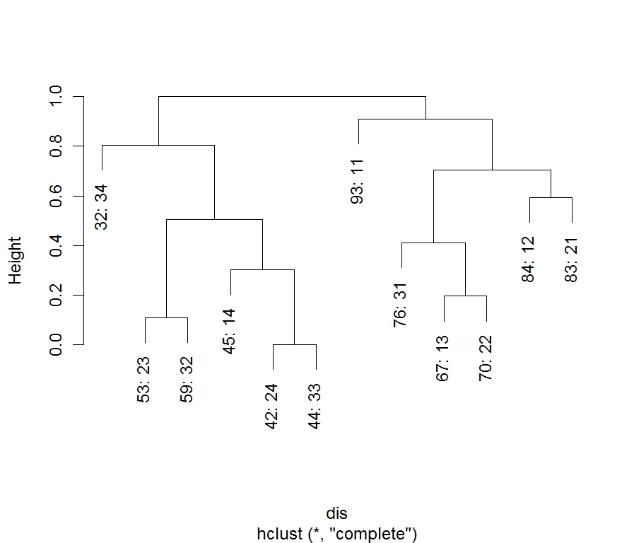

Slide 12
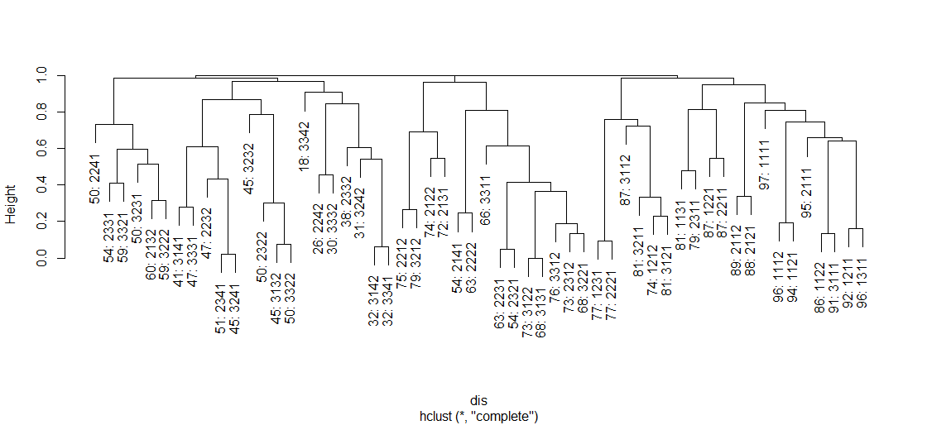
Breast Cancer– 4 Factors:
Size, Nodes, ER, and Grade

Slide 13
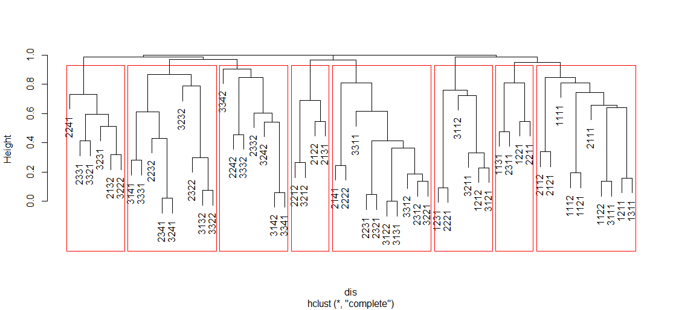
With More Factors, 8 Groupings are Shown Depending on Level of Cut

Slide 14
10-Year Survival Rates for 8 Groups Shown in Previous Slide . All Significant Statistically*
*Log Rank Test

Slide 15
Number of Cases in Each of 4 Groups for 12 T,N Factors
1 2 3 4
11 0 0 50580 0
12 0 0 0 11925
13 0 0 0 3036
14 0 697 0 0
21 0 0 0 14567
22 0 0 0 9343
23 0 4768 0 0
24 0 1560 0 0
31 0 0 0 872
32 0 974 0 0
33 0 1102 0 0
34 525 0 0 0
>
>
Codes

Slide 16
Survival Rates for Each of the 12 Combination of the T and N

Slide 18

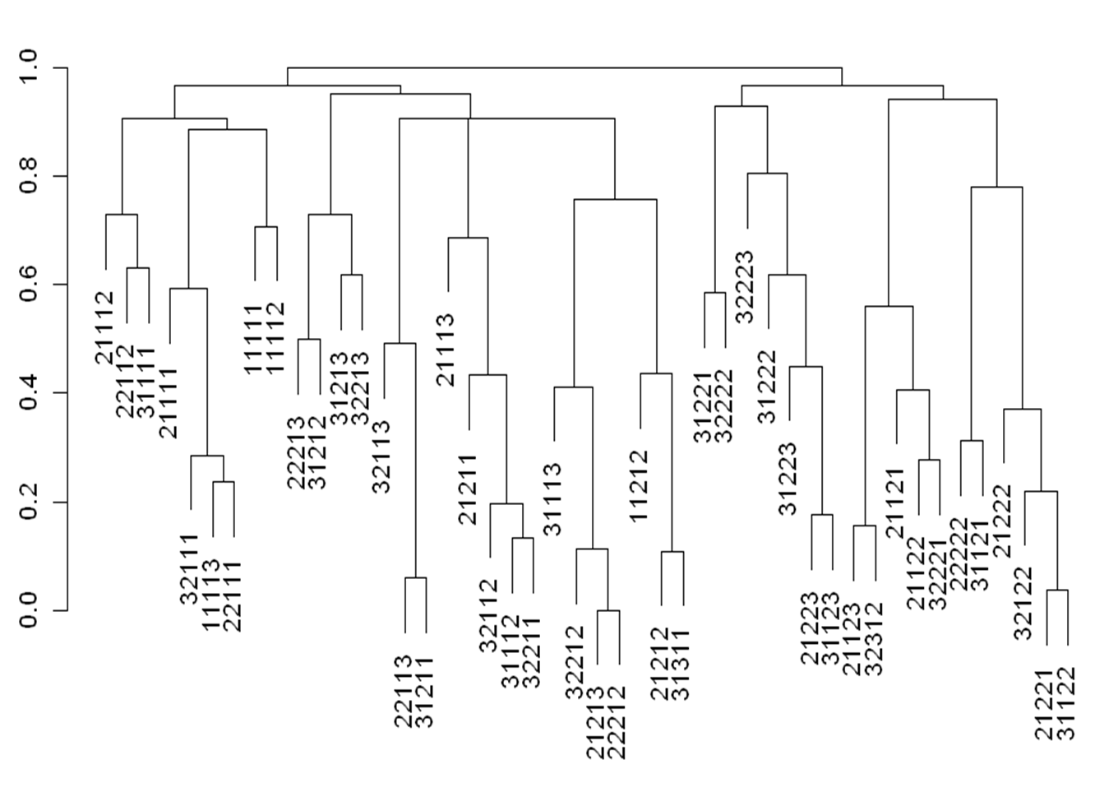

Slide 19
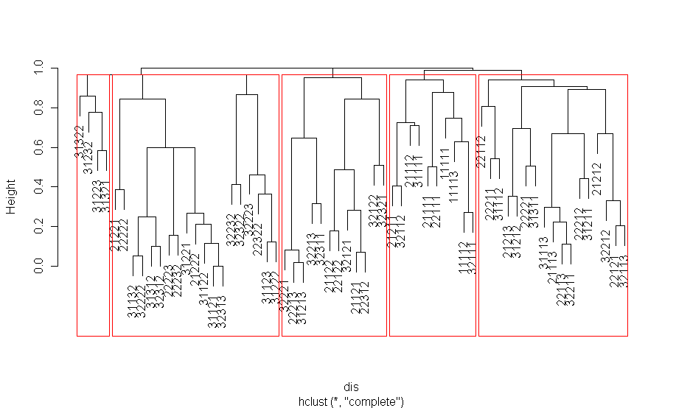
Male. 5-Yr Cluster Groups that Represent 5 Stages of
Lung Cancer, Adenocarcinomas Only

Slide 20
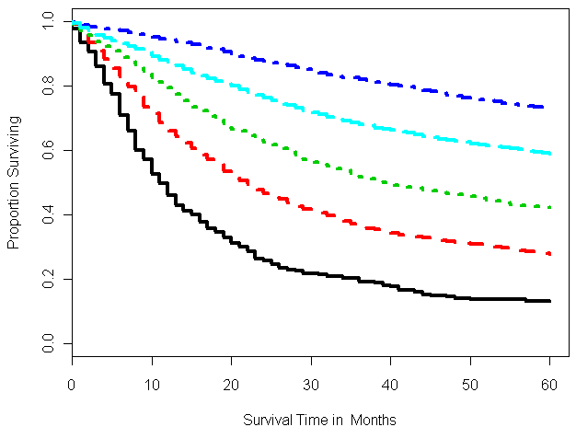
Male 5-Yr Disease Specific Survival with 5 Clusters Shown on Previous Slide

Slide 21
Survival rates for T1N2 Breast Cancers According to the Histological Grade
Survival Rate
Grade 1
Grade 2
Grade 3
Months since Diagnosis

Slide 22
Compares Survival Rates for T2N2 Cases of Breast Cancer when Additional Prognostic Factors are Added to the TNM
Survival Rate
T2N2 (n=6745)
T2N2, Grade 1, ER+, Age >50 (n=134)
T2N2, Grade 3, ER-, Age>50 (n=665)
Months since Diagnosis

Slide 23
Survival Rates for T1N2, Lung Cancers According to the Histological Grade
T1N2 (n=2716)
T1N2, Grade 1 (n=256)
T1N2, Grade 2 (n=1118)
T1N2, Grade 3 (n=913)

Slide 26
Upshot
1. Develop and validate new staging systems.
2. Integrate any number, type of prognostic factors without changing the TNM definitions.
3. Determine redundant prognostic factors for cost savings.
4. Survival is relative depending on number and type of factors selected in the calculation.
5. Patients with different prognostic factors can have similar survival rates.
6. Personalize medicine. Outcome prediction can be made from previous patients with exactly same prognostic factors.

